Slide 1
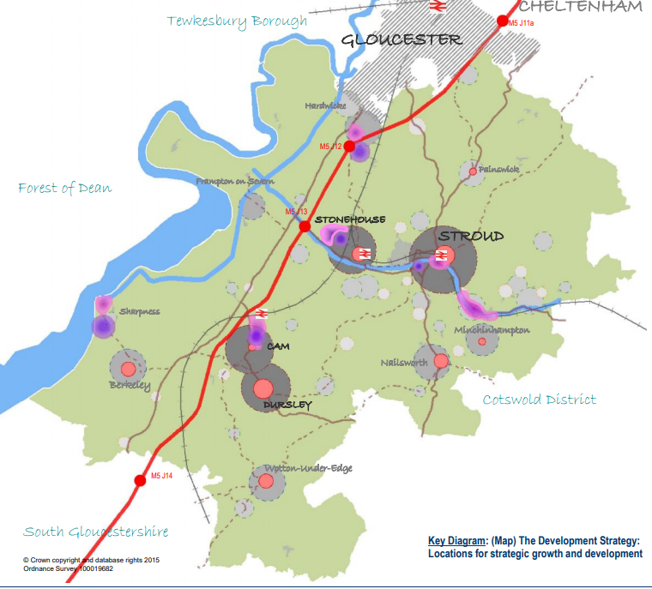
Developer Contributions in the Stroud District
Stroud District has a dual system:
S106 – Allocated Sites in the adopted Local Plan
CIL – all other developments (windfall sites)
CIL largely replaces old S106 approach
S106 Agreements are ‘site specific’
ensures the planning application is acceptable in planning terms
S106 agreements may include in-kind and financial contributions from the developer
Both CIL and S06 help to address additional pressures placed on infrastructure by new housing development

Slide 2
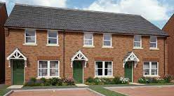
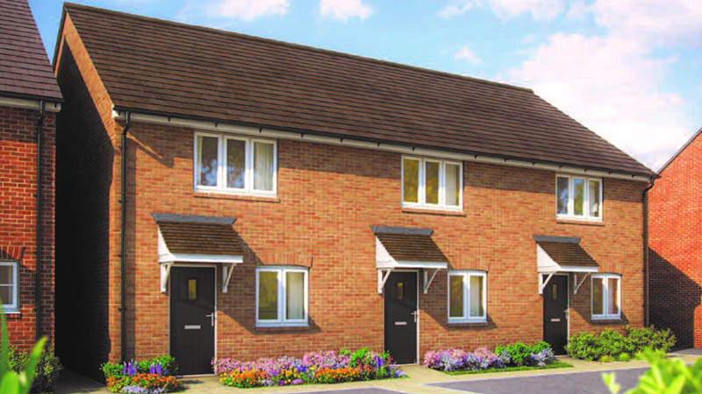
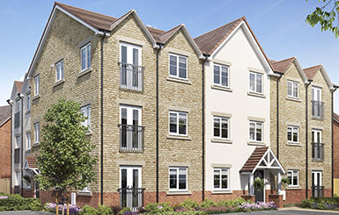
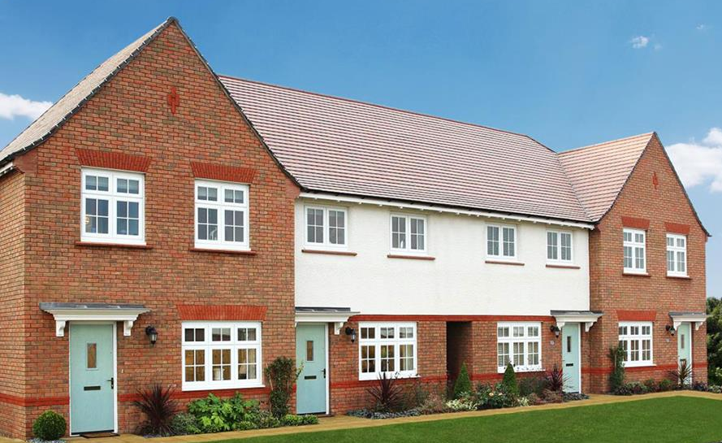
Community Infrastructure Levy (CIL)
A planning charge, introduced by the Government through the Planning Act 2008.
Provides a fair and transparent means for ensuring that development contributes to the cost of the infrastructure it will ultimately rely on.

Slide 3
SDC’s CIL charging Schedule implemented April 2017
CIL payments : calculated on new residential floorspace (some exemptions, eg, self-build)
Collected from developers according to payment schedule
CIL Neighbourhood Portion
25% if the area has an adopted NDP*
15% if the area does not have a NDP*
*Neighbourhood Development Plan
CIL Strategic Infrastructure Budget
Delivery of infrastructure planning priorities as set in the Local Plan, Infrastructure Delivery Plan (IDP) and Infrastructure Funding Statement (IFS)

Slide 4
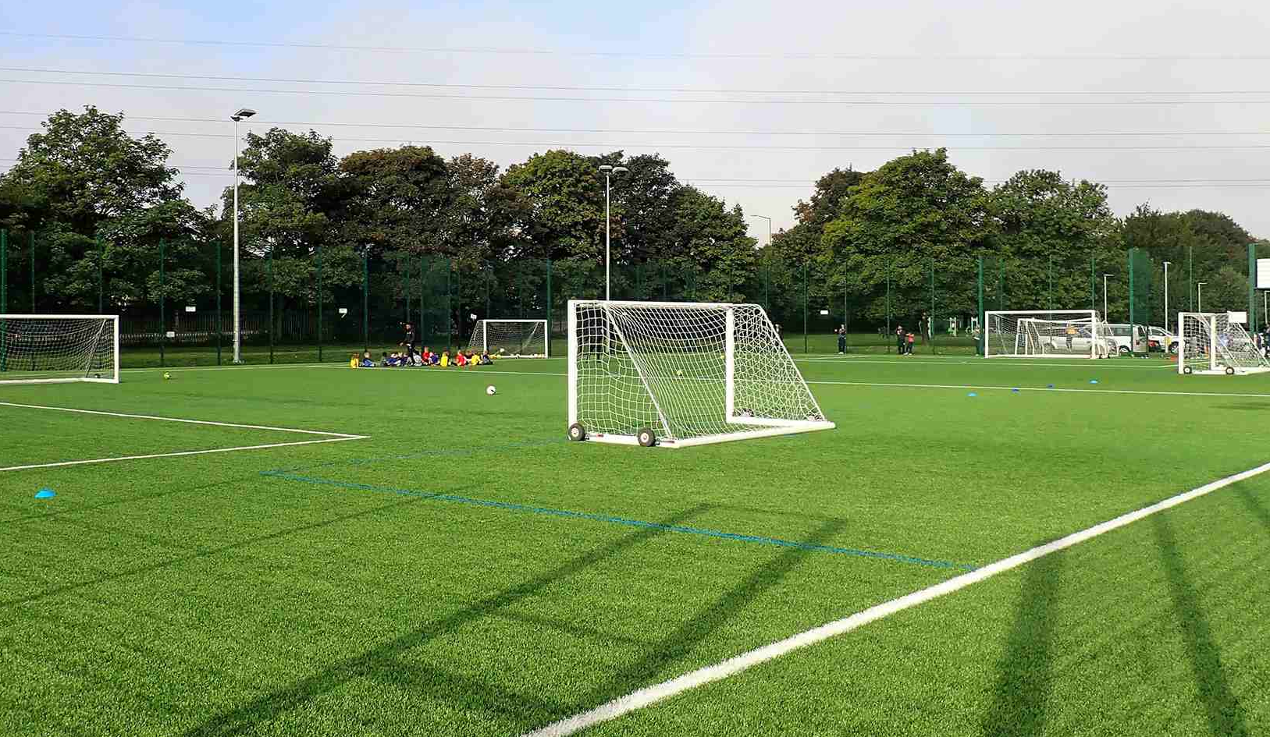
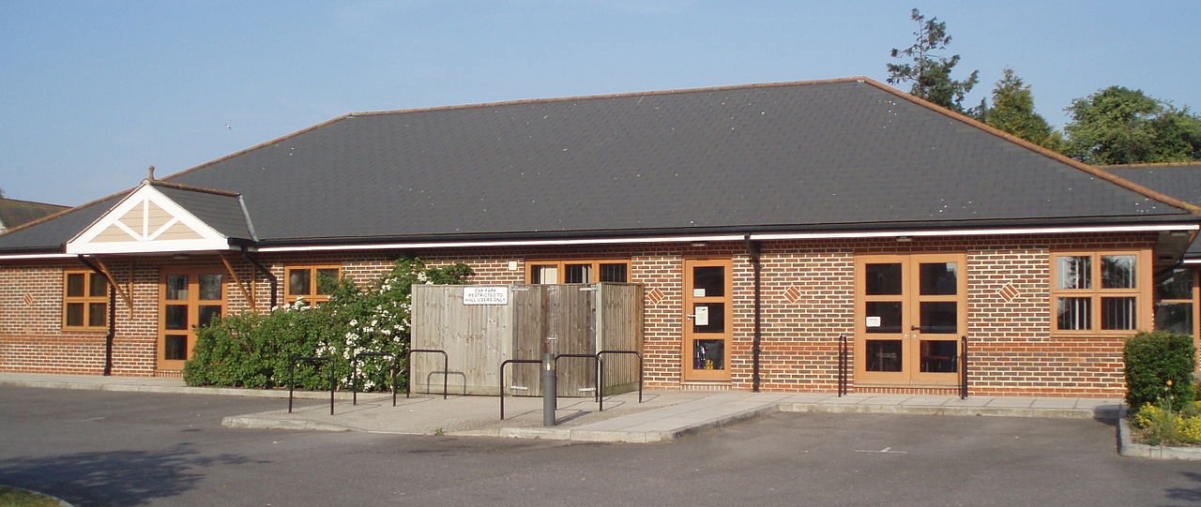
CIL Neighbourhood Portion
Over £555k given to Parish and Town Councils so far
Collected from new housing in their area
Given out every 6 months (April & October)
5 years to spend from receipt (reporting required)

Slide 5
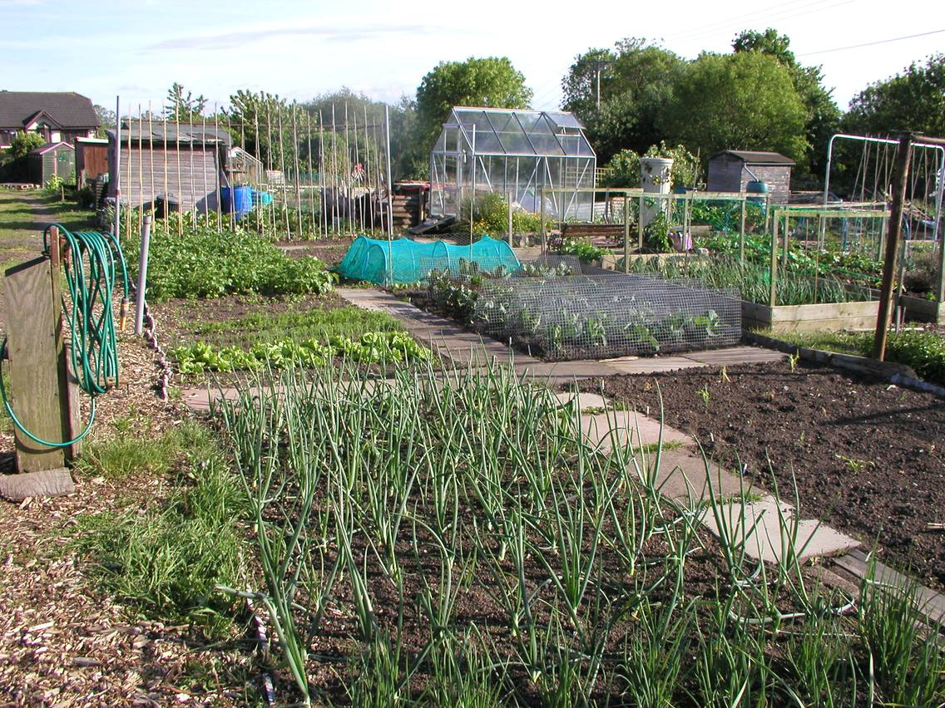
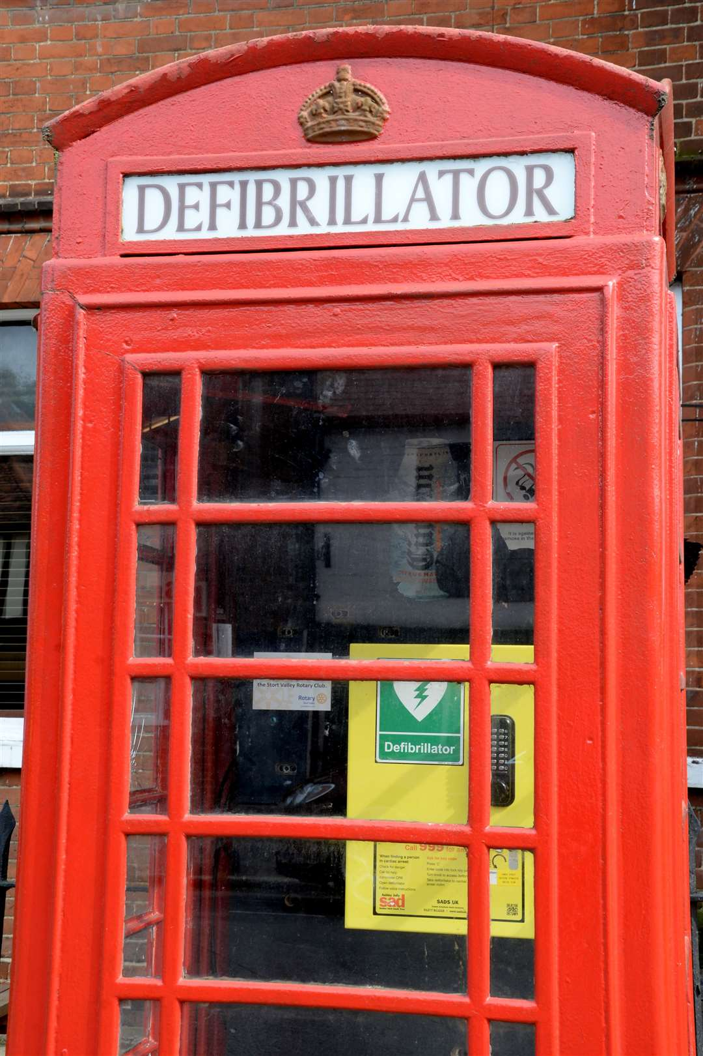
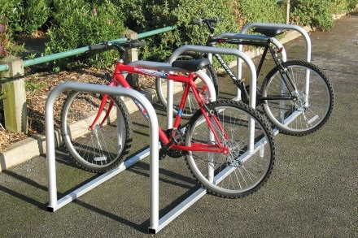
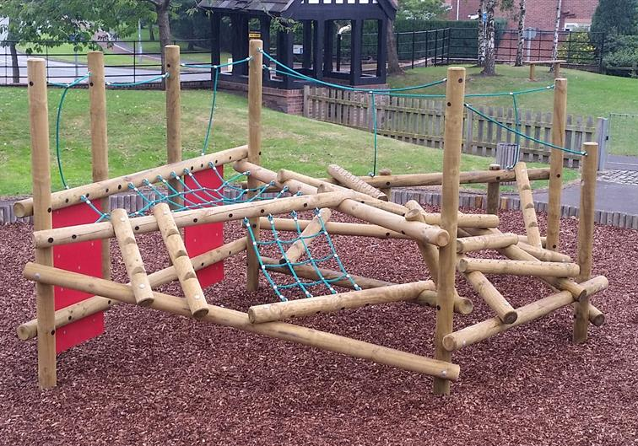
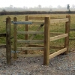
CIL Neighbourhood Portion
Can be used to fund anything (excl. land purchase)
Town Parish Councils decide – your priorities!

Slide 6
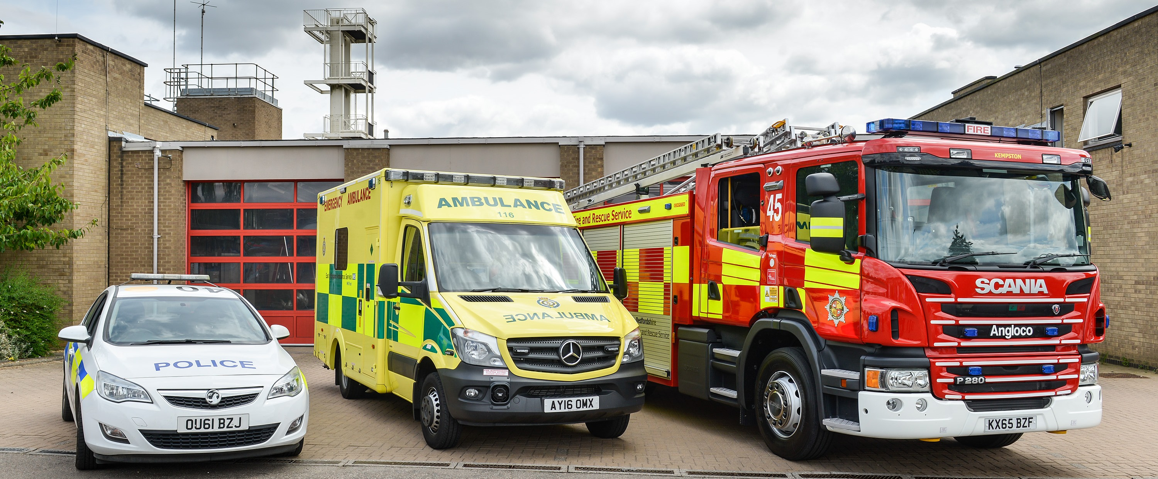
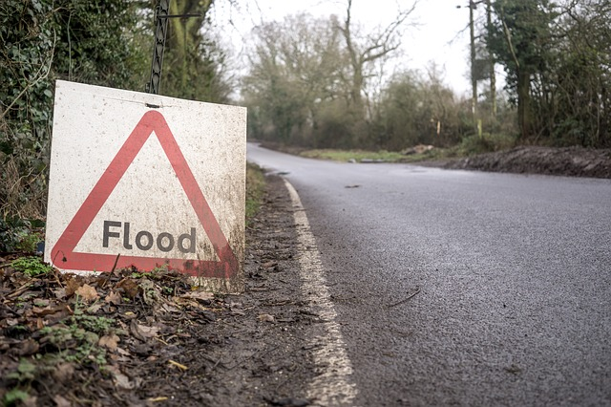
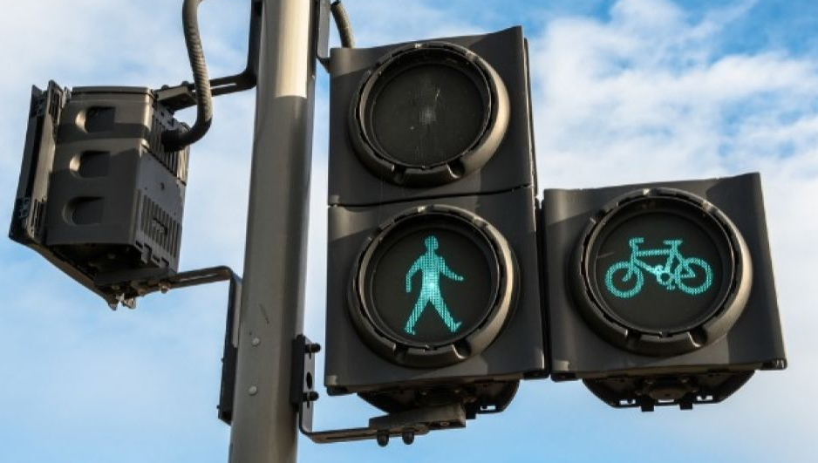
CIL Strategic Infrastructure
Supports delivery of much larger infrastructure; ‘big ticket’ services and facilities – beyond neighbourhood level
Responds to additional pressures created by new housing development
Serves a much wider geographical area than the area in which it is located – ‘Strategic’
Helps deliver growth priorities as set in the Local Plan, IDP, IFS

Slide 7
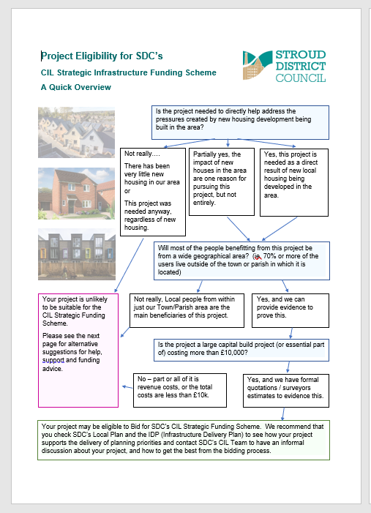
SDC’s CIL Strategic Infrastructure Funding Scheme
Most Town Parish Councils are not responsible for delivery of ‘strategic infrastructure’, but you can influence and support infrastructure investment by…
evidencing community priorities
working in partnership with larger orgs, eg, GCC
Think you have a ‘Strategic Project’? Go to the Town and Parish Councils link of our CIL website pages www.stroud.gov.uk/cil
Here you will find an ‘Eligibility Helpsheet’ and
other helpful information
Strategic Infrastructure Funding Scheme has an annual project bidding round – closing date is in Sept of each year

Slide 8
CIL Opportunities - summary
Collected from new housing : must help to address associated infrastructure needs
Local community projects = Neighbourhood Portion only
Bigger than local = ‘Strategic’ Infrastructure (see IDP and Local Plan)
8
Always happy to help! Contact us: cil@stroud.gov.uk

